Slide 1
Intel 8086 MICROPROCESSOR ARCHITECTURE
8086 System Connections, Timing, & Troubleshooting

Slide 2
MICROCOMPUTER
A microcomputer system is one which uses a microprocessor as its CPU
In addition the microcomputer also has a memory unit, input/output devices and system buses.
The system buses are of three types:
1.Address bus
2.Data bus
3.Control bus
Physically buses are group of wires

Slide 3
8086 BUSES
The 8086 has
20 address lines
16 data lines
4-10 control lines.
With this the 8086 is able
To address 1,048,576 (2²⁰ ) memory locations/ports.
To manipulate and/or operate on 16-bits(2-bytes) of data at a time.
To generate necessary control signals.

Slide 4
ARCHITECTURE
The internal architecture of 8086 can be mainly divided into two units:
Bus Interface Unit (BIU)
Execution Unit (EU)
The BIU Contains :
Code Segment Register (CS)
Data Segment Register (DS)
Extra Segment Register (ES)
Stack Segment Register (SS) and
Instruction Pointer (IP)

Slide 5
ARCHITECTURE Cont
The EU contains the following 8-bit registers:
AH & AL (AX-16 BIT)
BH & BL (BX-16 BIT)
CH & CL (CX-16 BIT)
DH 7 DL (DX-16 BIT)
It also includes the following 16-bit registers:
Stack Pointer (SP)
Base Pointer (BP)
Source Index (SI)
Destination Index (DI)

Slide 6
8086 SYSTEM CONNECTIONS,TIMING & TROUBLESHOOTING

Slide 7
40
VCC
AD15
GND
1
A16-A19 & S3-S6
2
35
34
BHE/S7
33
MN/MX
32
RD
AD14 TO AD0
31
RQ/GTO(HOLD)
30
RQ/GT1(HLDA)
8086 CPU
29
LOCK (WR)
28
S2 (M/IO)
27
S1 (DT/R)
16
NMI
26
S0 (DEN)
17
INTR
18
25
QS0 (ALE)
CLK
19
24
QS1(INTA)
GND
20
23
TEST
22
READY
21
RESET

Slide 8
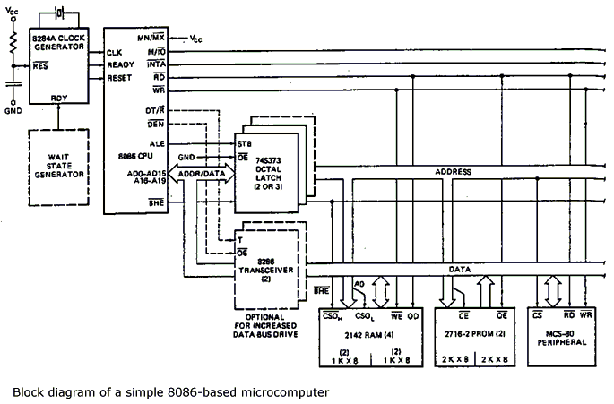
Basic 8086 System Overview

Slide 9
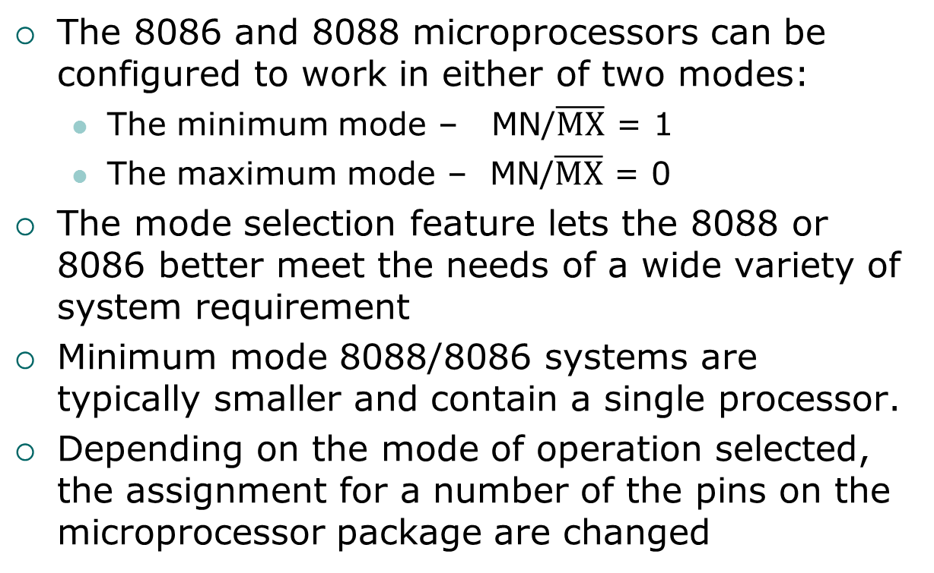
Minimum-Mode and Maximum- Mode System

Slide 10
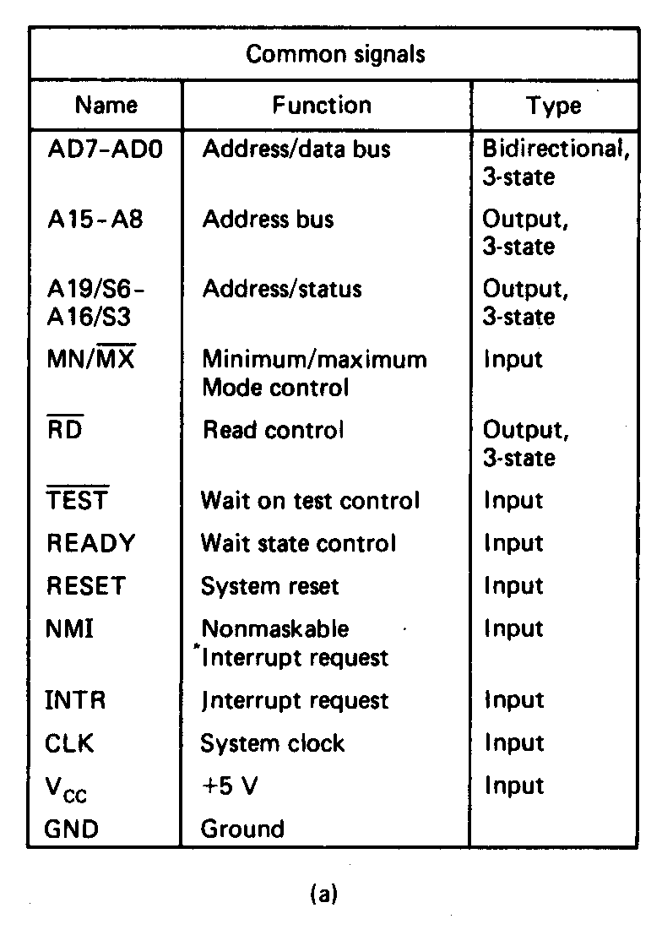
Minimum-Mode and Maximum- Mode System (cont.)
Signals common to both minimum and maximum mode

Slide 11
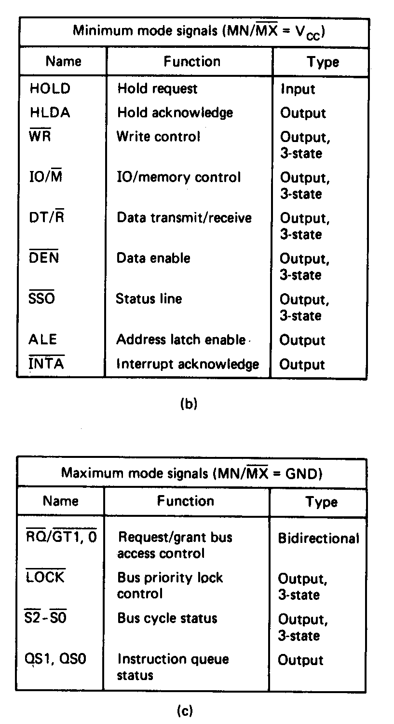
Minimum-Mode and Maximum- Mode System (cont.)
Unique minimum-mode signals

Slide 12
Minimum-Mode and Maximum- Mode System (cont.)
Unique maximum-mode signals

Slide 13
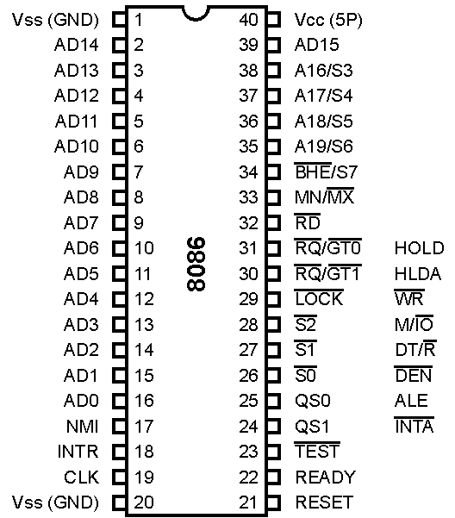
AD₀ – AD₁₅ Pin 16-2, 39 (Bi-directional)
These lines are multiplexed bi-directional address/data bus.
During T₁, they carry lower order 16-bit address.
In the remaining clock cycles, they carry 16-bit data.
AD₀-AD₇ carry lower order byte of data.
AD₈-AD₁₅ carry higher order byte of data.

Slide 14
A₁₉/S₆, A₁₈/S₅, A₁₇/S₄, A₁₆/S₃ Pin 35-38 (Unidirectional)
These lines are multiplexed unidirectional address and status bus.
During T₁, they carry higher order 4-bit address.
In the remaining clock cycles, they carry status signals.

Slide 15
BHE / S₇ Pin 34 (Output)
BHE stands for Bus High Enable.
BHE signal is used to indicate the transfer of data over higher order data bus (D₈ – D₁₅).
8-bit I/O devices use this signal.
It is multiplexed with status pin S₇.

Slide 16
RD (Read) Pin 32 (Output)
It is a read signal used for read operation.
It is an output signal.
It is an active low signal.

Slide 17
READY Pin 22 (Input)
This is an acknowledgement signal from slower I/O devices or memory.
It is an active high signal.
When high, it indicates that the device is ready to transfer data.
When low, then microprocessor is in wait state.

Slide 18
RESET Pin 21 (Input)
It is a system reset.
It is an active high signal.
When high, microprocessor enters into reset state and terminates the current activity.
It must be active for at least four clock cycles to reset the microprocessor.

Slide 19
INTR Pin 18 (Input)
It is an interrupt request signal.
It is active high.
It is level triggered.

Slide 20
NMI Pin 17 (Input)
It is a non-maskable interrupt signal.
It is an active high.
It is an edge triggered interrupt.

Slide 21
TEST Pin 23 (Input)
It is used to test the status of math co-processor 8087.
The BUSY pin of 8087 is connected to this pin of 8086.
If low, execution continues else microprocessor is in wait state.

Slide 22
CLK Pin 19 (Input)
This clock input provides the basic timing for processor operation.
It is symmetric square wave with 33% duty cycle.
The range of frequency of different versions is 5 MHz, 8 MHz and 10 MHz.

Slide 23
V_{CC} and V_{SS} Pin 40 and Pin 20 (Input)
V_{CC} is power supply signal.
+5V DC is supplied through this pin.
V_{SS} is ground signal.

Slide 24
MN / MX Pin 33 (Input)
8086 works in two modes:
Minimum Mode
Maximum Mode
If MN/MX is high, it works in minimum mode.
If MN/MX is low, it works in maximum mode.

Slide 25
MN / MX Pin 33 (Input)
Pins 24 to 31 issue two different sets of signals.
One set of signals is issued when CPU operates in minimum mode.
Other set of signals is issued when CPU operates in maximum mode.

Slide 26
Pin Description for Minimum Mode

Slide 27
INTA Pin 24 (Output)
This is an interrupt acknowledge signal.
When microprocessor receives INTR signal, it acknowledges the interrupt by generating this signal.
It is an active low signal.

Slide 28
ALE Pin 25 (Output)
This is an Address Latch Enable signal.
It indicates that valid address is available on bus AD₀ – AD₁₅.
It is an active high signal and remains high during T₁ state.
It is connected to enable pin of latch 8282.

Slide 29
DEN Pin 26 (Output)
This is a Data Enable signal.
This signal is used to enable the transceiver 8286.
Transceiver is used to separate the data from the address/data bus.
It is an active low signal.

Slide 30
DT / R Pin 27 (Output)
This is a Data Transmit/Receive signal.
It decides the direction of data flow through the transceiver.
When it is high, data is transmitted out.
When it is low, data is received in.

Slide 31
M / IO Pin 28 (Output)
This signal is issued by the microprocessor to distinguish memory access from I/O access.
When it is high, memory is accessed.
When it is low, I/O devices are accessed.

Slide 32
WR Pin 29 (Output)
It is a Write signal.
It is used to write data in memory or output device depending on the status of M/IO signal.
It is an active low signal.

Slide 33
HLDA Pin 30 (Output)
It is a Hold Acknowledge signal.
It is issued after receiving the HOLD signal.
It is an active high signal.

Slide 34
HOLD Pin 31 (Input)
When DMA controller needs to use address/data bus, it sends a request to the CPU through this pin.
It is an active high signal.
When microprocessor receives HOLD signal, it issues HLDA signal to the DMA controller.

Slide 35
Pin Description for Maximum Mode

Slide 36
QS₁ and QS₀ Pin 24 and 25 (Output)
These pins provide the status of instruction queue.
QS₁ | QS₀ | Status
0 | 0 | No operation
0 | 1 | 1st byte of opcode from queue
1 | 0 | Empty queue
1 | 1 | Subsequent byte from queue

Slide 37
S₀, S₁, S₂ Pin 26, 27, 28 (Output)
These status signals indicate the operation being done by the microprocessor.
This information is required by the Bus Controller 8288.
Bus controller 8288 generates all memory and I/O control signals.

Slide 38
S₀, S₁, S₂ Pin 26, 27, 28 (Output)
S₂ | S₁ | S₀ | Status
0 | 0 | 0 | Interrupt Acknowledge
0 | 0 | 1 | I/O Read
0 | 1 | 0 | I/O Write
0 | 1 | 1 | Halt
1 | 0 | 0 | Opcode Fetch
1 | 0 | 1 | Memory Read
1 | 1 | 0 | Memory Write
1 | 1 | 1 | Passive

Slide 39
LOCK Pin 29 (Output)
This signal indicates that other processors should not ask CPU to relinquish the system bus.
When it goes low, all interrupts are masked and HOLD request is not granted.
This pin is activated by using LOCK prefix on any instruction.

Slide 40
RQ/GT₁ and RQ/GT₀ Pin 30 and 31 (Bi-directional)
These are Request/Grant pins.
Other processors request the CPU through these lines to release the system bus.
After receiving the request, CPU sends acknowledge signal on the same lines.
RQ/GT₀ has higher priority than RQ/GT₁.

Slide 41
TIMING SEQUENCE
An external clock generator device is connected to 8086 to provide clock signals throughout the system.
One cycle of clock is called a state or t-state.
Each basic operation such as reading a memory location or writing to a port requires several states. This group of states is called a machine cycle.
The total time required to fetch and execute an instruction is called an instruction cycle. An instruction cycle consists of one or more machine cycle.

Slide 42
BASIC SIGNAL FLOW ON 8086 BUSES
Basically there are two operations to see:
1.Read operation
2. Write operation
Will see what is going on during this two cycles of operation.

Slide 43
READ CYCLE
Here we will see the activities carried out on 8086 buses at various time instants when it reads from a memory location or from a port.
Here we will assume that the 8086 is operated in is minimum mode.

Slide 44
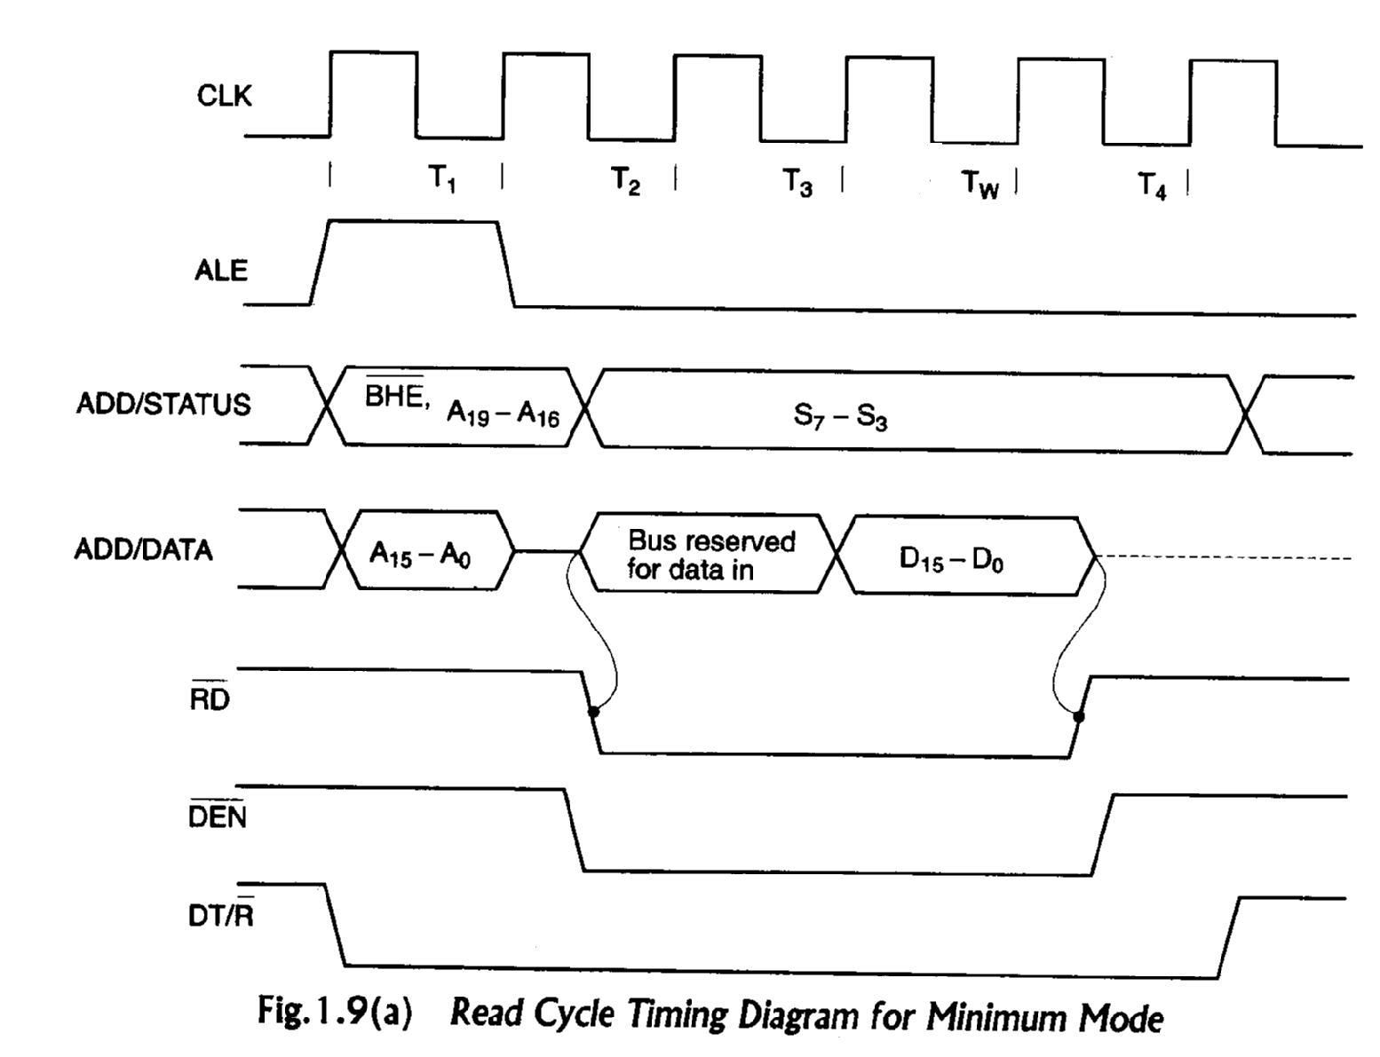

Slide 45
T1
T2
T3
T_{W}
T4
CLK
M/IO
ALE
ADDR/ DATA
MEMORY ACCESS TIME
A15-A0
RESERVED FOR DATA
VALID D15-D0
ADDR/ STATUS
A19-A16
RD
READY
DT/R
DEN

Slide 46
WRITE CYCLE
Here we will see the activities carried out on 8086 bus at various time instants when it writes to a port or a memory location.
Here we will assume that the 8086 is operated in is minimum mode.

Slide 47
T1
T2
T3
T_{W}
T4
CLK
M/IO
ALE
ADDR/ DATA
A15-A0
DATA OUT (D15-D0)
ADDR/ STATUS
A19-A16
WR
READY
DT/R
DEN

